Slide 1
To be able to identify lines of symmetry
I can find lines of symmetry by folding shapes.
I can find lines of symmetry using a mirror.

Slide 2
What is a line of symmetry?

Slide 3
Symmetry
If a shape can be folded exactly in half, then we say that shape has got line symmetry.

Slide 4
One line of symmetry.
A

Slide 5
Two lines of symmetry.
H

Slide 6
No lines of symmetry.
Z

Slide 7
Even more lines of symmetry!

Slide 8
Task 1
With the person next to you, investigate the shapes you have been given.
What shape is it?
How many lines of symmetry does it have?
Record on the table you have been given.

Slide 9
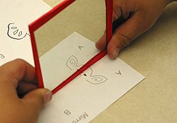
Mirror Symmetry
If you put a mirror along the line of symmetry, the shape looks the same as without the mirror.

Slide 10
Task 2
Try using a mirror along the line of symmetry you have found on your folded shapes.
What do you notice?

Slide 11
There are lines of symmetry all around us!

Slide 12
Task 3
Which of your symbols and shapes have lines of symmetry?
Do they have more than one?
Use the mirror to find out!

