Slide 1
PHYSICS CLASS 9 DEFORMATION Ms. UZMA AMIR Date: 15-5-2015

Slide 2
Effect of Force(Deformation)
Change in Speed
Change in Direction
Change in Shape

Slide 3
DEFORMATION
ELASTIC DEFORMATION
LEARNING OUT COMES

Slide 4
ELASTIC DEFORMATION
State that a force may produce a change in size and shape of a body.
Plot, draw and interpret extension-load graphs for an elastic solid and describe the associated experimental procedure.
Recognise the significance of the term "limit of proportionality" for an elastic solid.
Calculate extensions for an elastic solid using proportionality.

Slide 5
Deformation
Deformation is a change in shape due to an applied force. This can be a result of tensile (pulling) forces, compressive (pushing) forces, shear, bending or torsion (twisting).
Elastic deformation - This type of deformation is reversible. Once the forces are no longer applied, the object returns to its original shape.
Plastic deformation - This type of deformation is not reversible. However, an object in the plastic deformation range will first have undergone elastic deformation, which is reversible, so the object will return part way to its original shape.

Slide 6
Elasticity
Elasticity is the property of an object or material which causes it to be restored to its original shape after distortion.
It is said to be more elastic if it restores itself more precisely to its original configuration.
The piano wire is harder to stretch, but would be said to be more elastic than the rubber band because of the precision of its return to its original length.

Slide 7
Experimental Procedure
Aim: To study the deformation of a spring
Apparatus:
Spring
100 g slotted mass
Metre rule
Retort stand

Slide 8
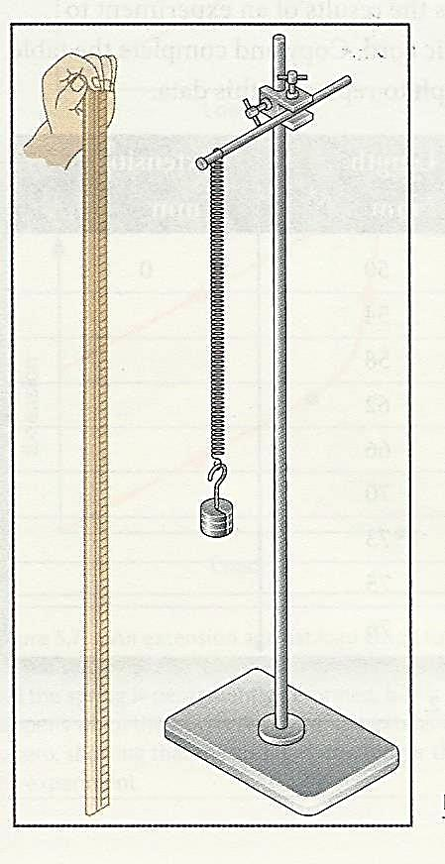
Procedure:
Arrange the apparatus as shown below
Measure the length of the unstretched spring.
Measure the length of the stretched spring as a mass is added.
Repeat procedure.

Slide 9
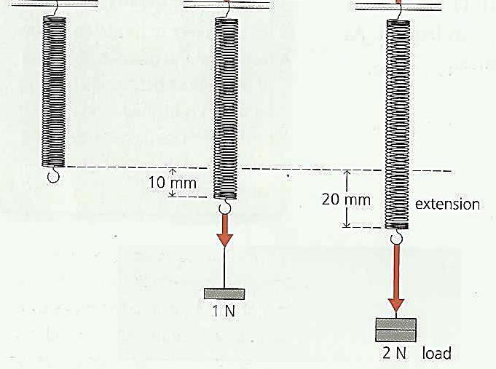
Calculation
The load (force) for every mass (100 g) is found by using w = mg.
The extension of the spring is the difference between its stretched and unstrectched lengths.

Slide 10
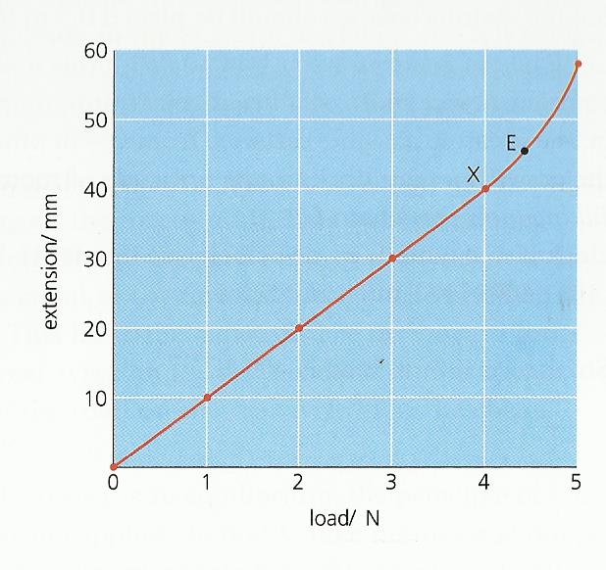
Graph
Plot the extension against load graph
The graph is divided into two parts
The graph slopes up steadily – the extension increase as load increases.
The graph bend – load is great the spring become permanently damage.

Slide 11
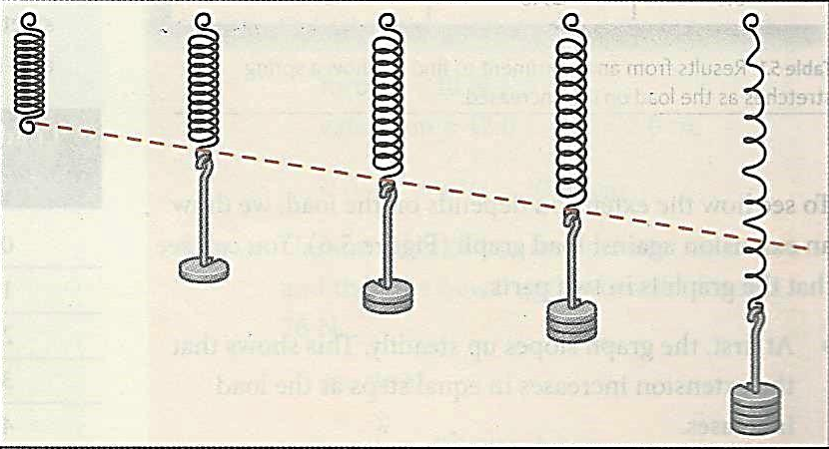
Conclusion
The line is straight, and passes through the origin.
Every 1 N increases in load produces the same extra extension.
If the load is doubled, the extension is doubled.
Extension/Load always have the same value.

Slide 12
Hooke’s Law
Hooke's law state that the extension of a spring is proportional to the load applied to it, provided the limit of proportionality (elasticity limit) is not exceeded.
In term of equation:
F = kx
where
F is the force applied
k is the stiffness of spring (spring constant)
x is the extension of the spring

Slide 13
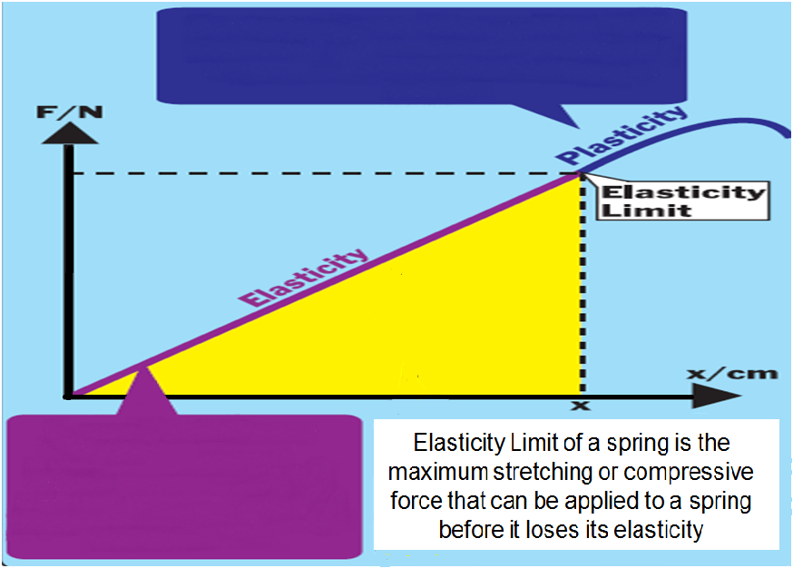
A region where any further extension would not cause it to return to its original form
A region where extension is proportional to a force applied. A returns to original form when force is removed.

Slide 14
Example
A helical spring of natural length 20 cm is stretched to 24 cm by a force of 20 N. What force is required to stretch the spring to a length of 30 cm?
A spring, of original length 10.0 cm stretches to 12.0 cm when a force of 40 N is applied to it. What is the extension of the spring when a force of 26 N is applied?
A 10 N load produced an extension of 5 cm. What force would produce an extension of 15 cm?
A spring has an unstrecthed length of 12.0 cm. its stiffness k is 8 N/cm. What load is needed to stretch the spring to a length of 15.0 cm?

Slide 15
A spring requires a load of 2.5 N to increase its length by 4 cm. the spring obeys Hooke’s Law. What load will give it an extension of 12 cm?
An elastic bungee cord has near plastic elasticity as long as the applied stretching force does not exceed 5.00 N. When no force is applied to the cord, it is 1.00 m long. When the applied force is 5.00 N, the band stretches to a length of 2.00 m. How long will the cord be if a stretching force of 2.00 N is applied?

Slide 16
In an experiment with a spiral spring, the following data were obtained.
Plot the graph of length against load, and from the graph find the following:
The length of the spring when it is not loaded.
The length of the spring when the load is 100 N.
The load required to produce an extension of 6 cm.
Predict what will happen to the spring if a 1000 N load is added onto it.
Length of Spring (cm) | 8.0 | 10.0 | 12.0 | 14.0
Load (N) | 40 | 90 | 140 | 190

Slide 17
In an experiment with a spring, these results were obtained.
Draw a graph of these results and from the graph find:
The length of the spring when unstretched.
The length of the spring when the load is 80 N.
The load needed to produce an extension of 5.0 cm.
Length of Spring (cm) | 9.0 | 11.0 | 13.0 | 15.0
Load (N) | 50 | 100 | 150 | 200
Deformation
17

Slide 18
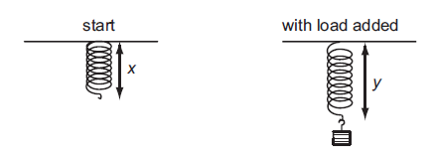
A student carries out an experiment to plot an extension / load graph for a spring. The diagrams show the apparatus at the start of the experiment and with a load added.
What is the extension caused by the load?
A | x | B | y | C | y + x | D | y - x
D

Slide 19
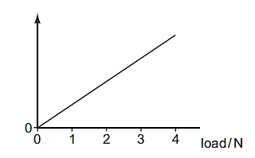
A student adds loads to an elastic cord. He measures the length of the cord for each load.
He then plots a graph from the results.

Slide 20
Which length is plotted on the vertical axis?
measured length
original length
(measured length – original length)
(measured length + original length)

Slide 21
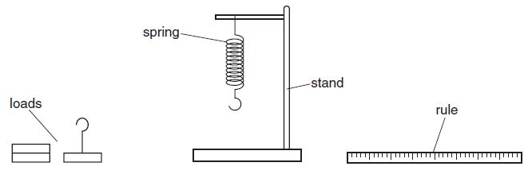
A spring is suspended from a stand. Loads are added and the extensions are measured.

Slide 22
Which graph shows the result of plotting extension against load?
D

Slide 23
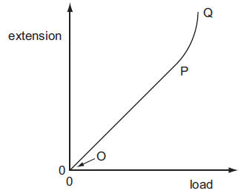
Which part of the graph shows the limit of proportionality for an elastic solid?
A | O | B | OP | C | P | D | PO
C

Slide 24
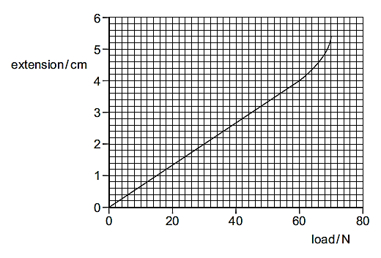
An extension-load graph for a wire is shown.
What is the load at the limit of proportionality for the wire?
A | 4 N | B | 15 N | C | 60 N | D | 70 N
C

Slide 25
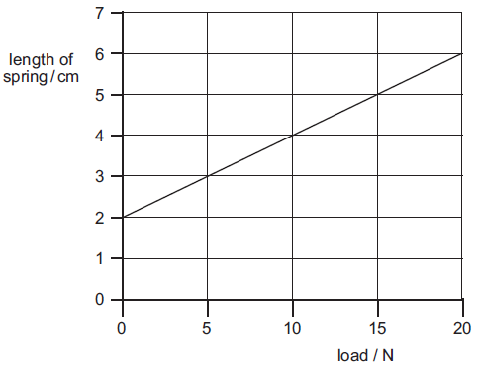
A spring balance is calibrated to give readings in newtons.
The graph shows how the length of the spring varies with the load.

Slide 26
A load causes the spring of the balance to extend by 3 cm.
What is the balance reading?
A | 3 N | B | 5 N | C | 10 N | D | 15 N
D

Slide 27
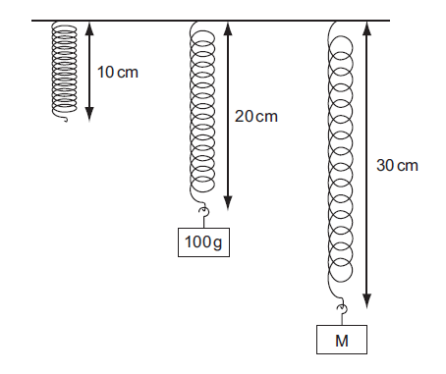
Objects with different masses are hung on a 10 cm spring. The diagram shows how much the spring stretches.

Slide 28
The extension of the spring is directly proportional to the mass hung on it.
What is the mass of object M?
110 g
150 g
200 g
300 g

Slide 29
The table shows how the extension of a spring varies with load.
Between which two loads would you find the limit of proportionality?
0 N and 2 N
8 N and 10 N
10 N and 12 N
14 N and 16 N

Slide 30
The table below shows the length of a wire as the load on it is increased.
Which graph correctly shows the extension of the wire plotted against load?

Slide 31
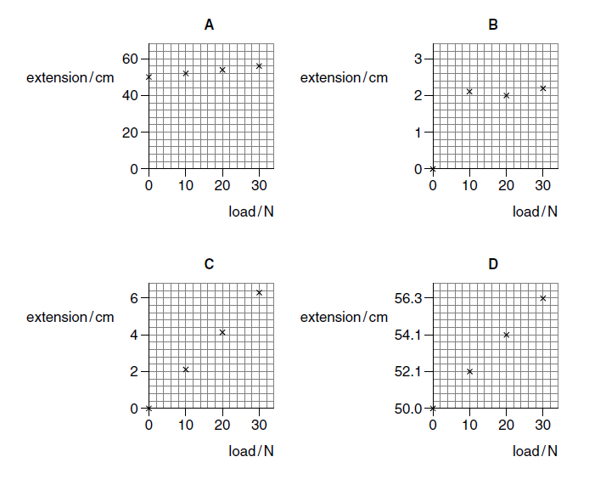
C

Slide 32
An experiment is carried out to measure the extension of a rubber band for different loads.
The results are shown below.
Which figure is missing from the table?
A | 16.5 | B | 17.3 | C | 17.4 | D | 18.3
B

Slide 33
A metal wire, initially 1.000 m long, extends by 4 mm when a load of 2 N is added to it.
What will the length of the wire be if a further 3 N is added, assuming it does not extend beyond its limit of proportionality?
1.060 m
1.080 m
1.010 m
1.012 m

