Slide 1
3D SYMMETRY

Slide 2
RECAP...
WHAT IS PLANE
SYMMETRY?

Slide 3
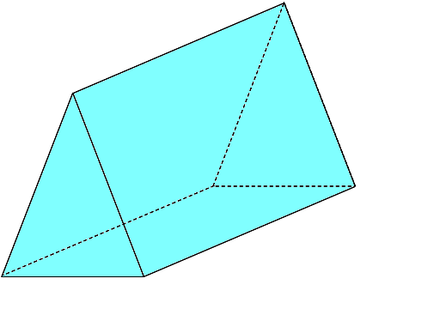
Triangular
Based Prism
Isosceles

Slide 4
Triangular Based Prisms

Slide 5
Triangular Based Prisms
An isosceles triangular based prism has 2 planes of symmetry.

Slide 6
Triangular Based Prisms
An isosceles triangular based prism has 2 planes of symmetry.

Slide 7
Triangular Based Prisms

Slide 8
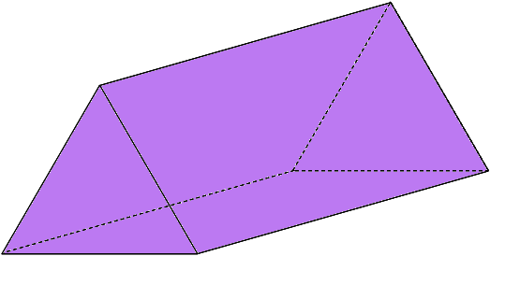
Triangular
Based Prism
Equilateral

Slide 9
Triangular Equilateral
Triangular Based Prisms

Slide 10
Triangular Based Prisms

Slide 11
Triangular Based Prisms

Slide 12
Triangular Based Prisms

Slide 13
Triangular Based Prisms
An equilateral triangular based prism has 4 planes of symmetry.

Slide 14
Worksheet 5
Triangular Based Prisms

Slide 15
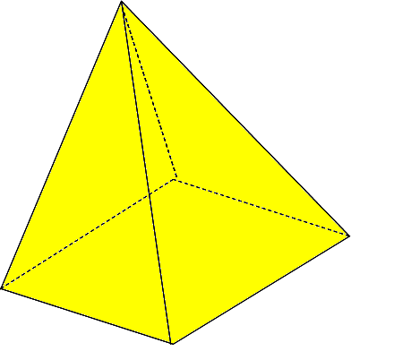
Pyramid
Rectangular
Based

Slide 16
Pyramids
Rectangular Based Pyramids

Slide 17
Rectangular Based Pyramids

Slide 18
Pyramids
Pyramids
A rectangular based pyramid has 2 planes of symmetry.

Slide 19
Worksheet 6
Pyramids
Pyramids

Slide 20
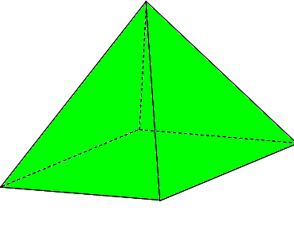
Pyramid
Square
Based

Slide 21
Square Based Pyramids

Slide 22
Square Based Pyramids

Slide 23
Square Based Pyramids

Slide 24
Square Based Pyramids

Slide 25
Pyramids
A square based pyramid has 4 planes of symmetry.

Slide 26
Worksheet 7
Pyramids

